Slide 2
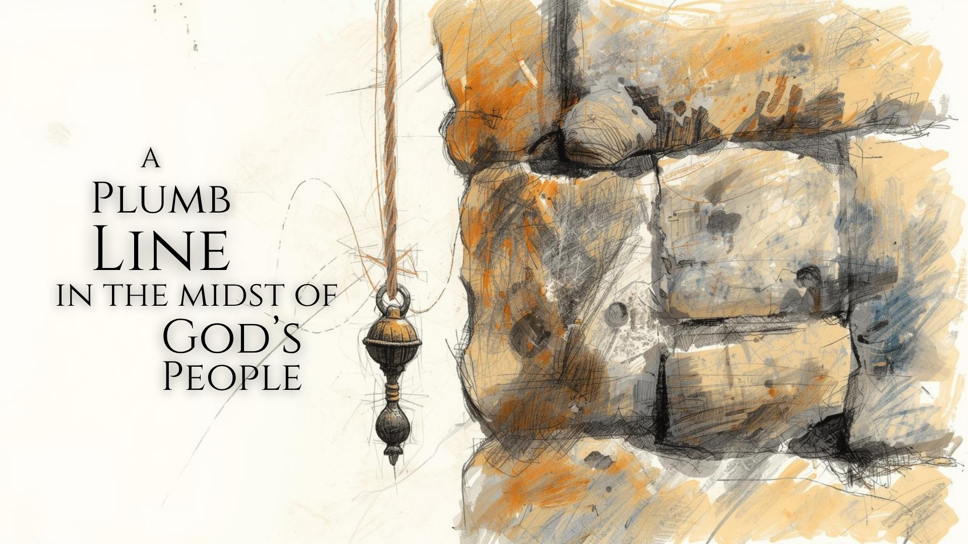

Slide 3
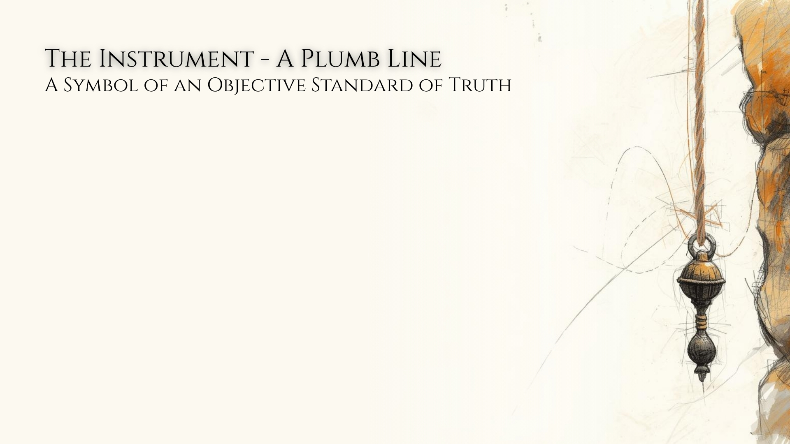
What is it?
“plumb line” – ănâḵ – “lead” (HALOT); “plummet, plumb, lead-weight” (BDB); “An inspector on a wall would carry a plummet, which materially would have consisted of a metal like lead.” (NIDOTTE)
“A plummet is a weight made of stone (cf. AV, NEB, Isa. 34:11) or metal which, when suspended by a cord, produces a plumb line. The plumb line is used to measure a straight vertical plane.” (ISBE)

Slide 4
What is it?
An objective standard of truth.
The law and the covenant for Israel – Exodus 19:3-6 (cf. Hebrews 7:11; Deut. 6:24-25) (cf. Psalm 19:7-11)
A divine objective standard of truth is the provision for fellowship with the immutable God – 2 Corinthians 6:14-7:1

Slide 5
Whose is it?
The plumb line belongs to God – Amos 7:7
Psalm 50:16-17 – My statutes, My covenant, My words.
Inspiration of God – Exodus 3:13-14; 7:1-2; 2 Peter 1:19-21; 2 Timothy 3:16-17; 1 Corinthians 14:37

Slide 6
Does it change?
The physical plumb line was based on the presupposition that gravity is an unalterable law of God.
God’s plumb line – Isaiah 28:16-19 – justice, righteousness.
Destruction – Isaiah 34:11; Lamentations 2:8
Matthew 21:44 – the variation comes with the interaction, not the standard itself.

Slide 7
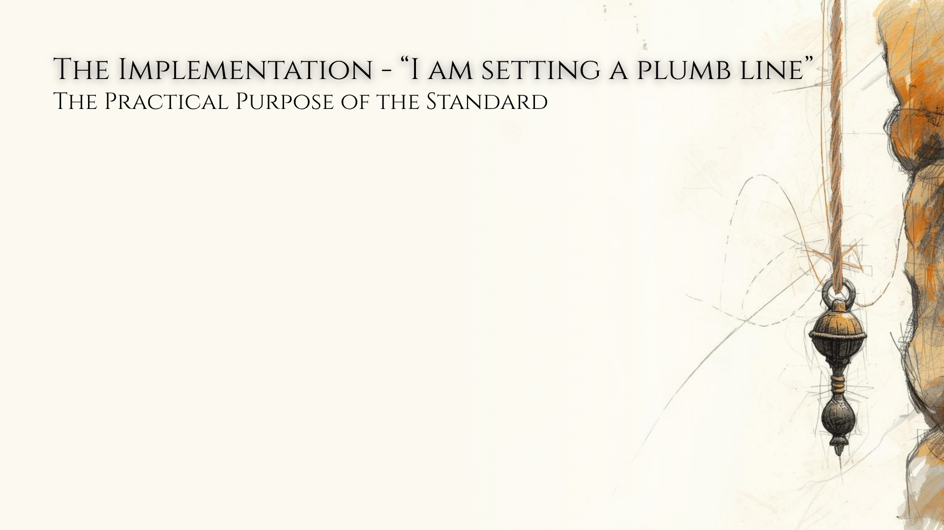
Who is it for?
“My people Israel” (Amos 7:8).
Entrance into covenant, establishment by revealed law – Deuteronomy 29:10, 12-13, 29
The law was for the Jews – Romans 3:1-2 (2:17-20)

Slide 8
Is it merely idealistic, or does it demand practice?
“revealed…that we may do all” – Romans 2:21-24 – but they did not.
The vision indicates the Israelites were expected to adhere to the standard but did not. (Amos 7:7-9)
Deuteronomy 30:11-14 – available, understandable, realistically practical.

Slide 9
Is it merely idealistic, or does it demand practice?
Comprehensive – 2 Peter 1:3
Understandable – Ephesians 3:4; 2 Timothy 1:13
Practical – Romans 1:5; Ephesians 4:13
Enforceable – 2 Timothy 3:16-17

Slide 10
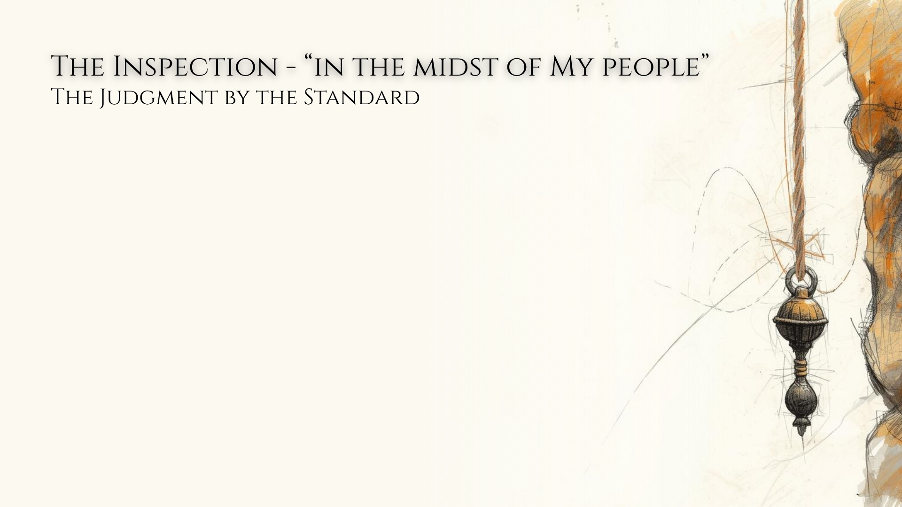
How is the standard used for inspection in relation to its subject?
Does the standard alter in relation to the subject?
“I am setting a plumb line in the midst of My people Israel” (Amos 7:8)
It remains plumb despite being in the midst of a crooked people. Its immutability is the only way the people are known to be crooked.
God’s standard does not bend for those disinclined to follow it – Matthew 7:21-23; James 2:8-13

Slide 11
Is the inspection one-dimensional, or multi-dimensional?
The plumb line was for verticality, but also stretched horizontally, and could even be used for measurement.
“whatever you do in word or deed” (Colossians 3:17)
Hebrews 4:11-13 – “all things”

Slide 12
What is the purpose of the inspection?
“I will not pass by them anymore” (Amos 7:8) – implying previous mercy and longsuffering, but present destruction. (cf. Exodus 34:6-7; Amos 2:13; 4:6-12)
Inspection by the standard is meant for correction – 2 Chronicles 36:15-16; Jeremiah 6:16
Inspection by the standard is meant for final judgment and condemnation – Amos 7:8; 8:1-3; 2 Kings 21:13; 2 Thessalonians 1:6-10

