Slide 2
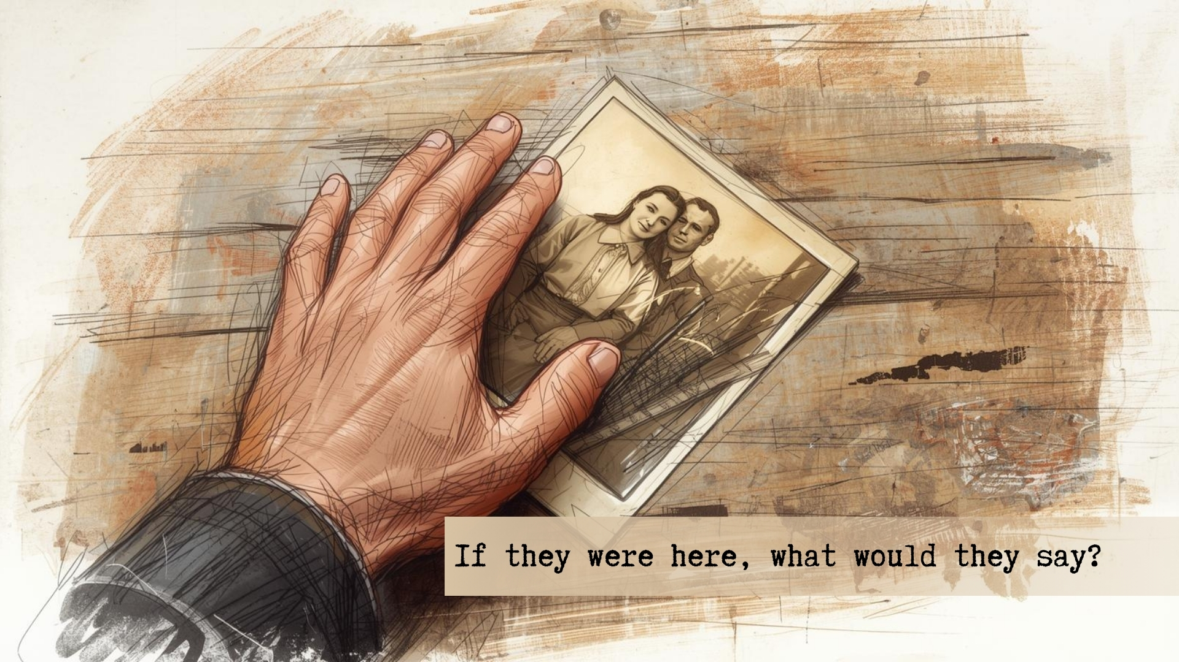

Slide 3

If you haven’t obeyed the gospel yet obey it now!
The Gospel is All That Matters
It is eternal – 1 Peter 1:23-25 (What it offers is eternal – v. 4)
It alone has the power to save – Romans 1:16
The Gospel is the Only Way
If you don’t obey you will be punished – 2 Thessalonians 1:8-9; Mark 16:15-16
Don’t neglect it – Hebrews 2:2-3
Now is the Only Guaranteed Time – Psalm 39:4-5

Slide 4
If you have sin in your life repent now!
Sin Isn’t Worth It
Things of the world will pass away – 1 John 2:15-17
The only lasting thing sin offers is regret – Revelation 1:7; 2 Thessalonians 1:9
Sin Really is a Big Deal
Any sin separates from God – Isaiah 59:2
Repent or perish! – Luke 13:1-5, 22-27
Now is the Only Guaranteed Time – 2 Peter 3:8-10, 15; 2 Corinthians 5:20-6:1-2

Slide 5
If you know someone in sin say something to them now!
Their Soul is Most Important
Don’t let anything keep you from telling them what they need to hear!
James 5:19-20 – covering a multitude of sins. (1 Peter 4:8 – with love)
To not warn is to be guilty of their blood – Ezekiel 33:8
Now is the Only Guaranteed Time
The rich man was too late – Luke 16:27-29

Slide 6
Don’t come to this place of torment!
This Place is Real
Shown with the rich man – Luke 16:22-24, 26, 28
A place of punishment in reservation for judgment – 2 Peter 2:4-9; 1 Peter 3:19-20
Day of judgment – Matthew 25:41
Nothing is Worth Keeping If It Means Coming Here
The rich man wanted his brothers to repent – Luke 16:27-28, 30
Do whatever it takes to avoid this punishment – Matt. 5:29-30
Is it worth your soul? – Mark 8:34-37

Slide 7
Do whatever it takes to come to Paradise!
This Place is Real
Shown with Lazarus – Luke 16:22, 25-26 – Abraham’s bosom.
A place of comfort in reservation for judgment – 2 Timothy 1:12; Luke 23:43, 46
Nothing is Too Much to Sacrifice to Come Here
There will be great reward for those who sacrifice – Matthew 19:27-29
Lazarus had nothing, but gained everything – Luke 16:20-21, 25

