Slide 2
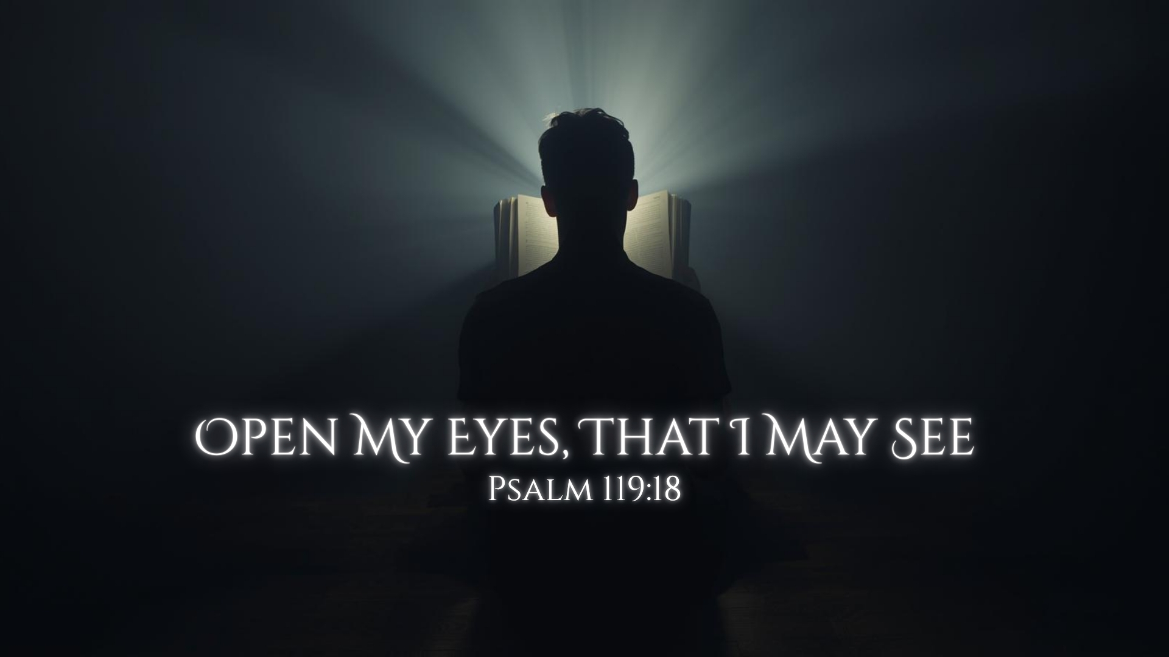

Slide 3
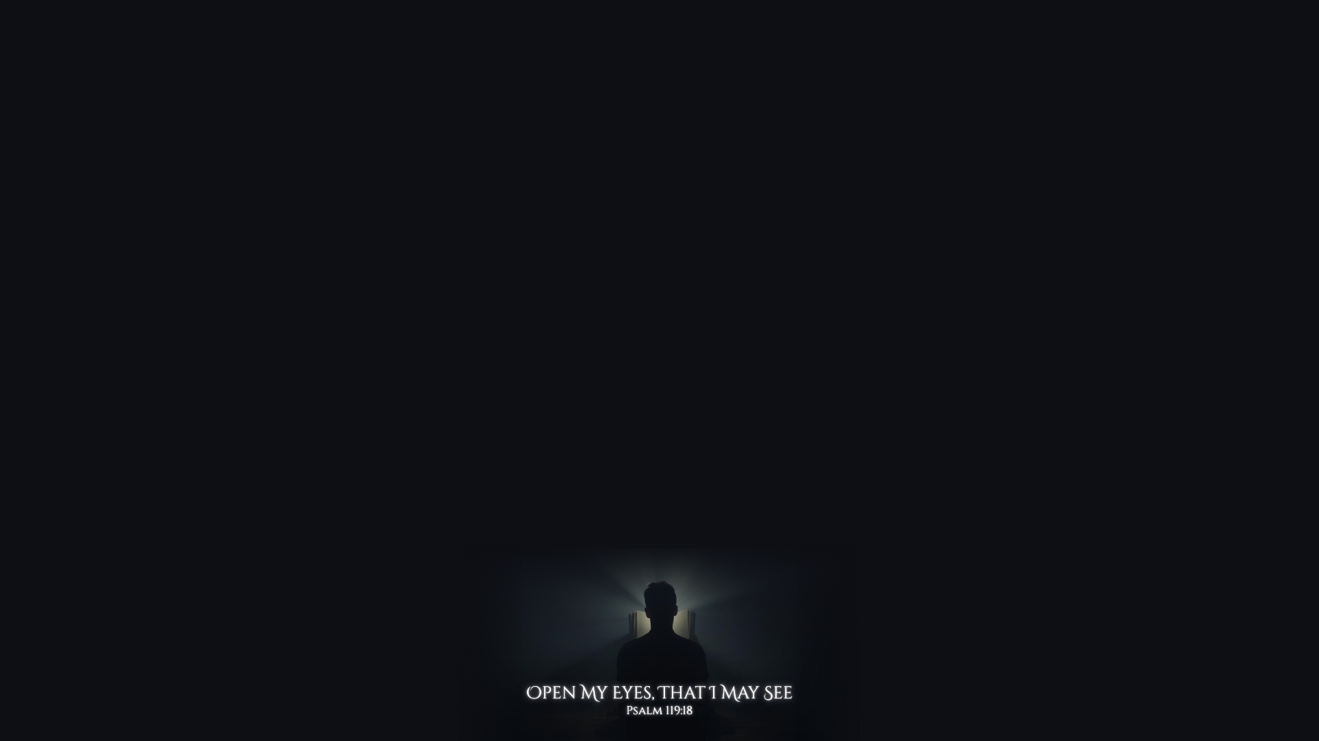
Implications from the Petition
There Are Things I Can See
1 Corinthians 2:15-3:4; John 9:39-41
There Are Things I Do Not Yet See
Ephesians 3:19; Philippians 4:7
I Need Help Seeing
James 1:5; Ephesians 1:17-18

Slide 4
Wondrous Things from Your Law
“Open my eyes, that I may see Wondrous things from Your law.” (Psalm 119:18)
Psalm 119:127, 162; John 10:10; Psalm 119:97-105

Slide 5
The Sin That So Easily Ensnares Me
“I am a stranger in the earth; Do not hide Your commandments from me.” (Psalm 119:19)
Romans 12:2; Hebrews 12:2; Proverbs 6:16-19

Slide 6
Where I Need to Improve Spiritually
“My soul breaks with longing For Your judgments at all times.” (Psalm 119:20)
1 Thessalonians 1:3; 4:1-2; Micah 6:8; Eph. 5:15-17; Matthew 25:24-30

Slide 7
The Goodness of God Despite an Unjust World
“Princes also sit and speak against me, But Your servant meditates on Your statutes.” (Psalm 119:23)
Romans 8:31; 2 Kings 6:15-17; 2 Cor. 5:7; 1 John 5:4

