Slide 2
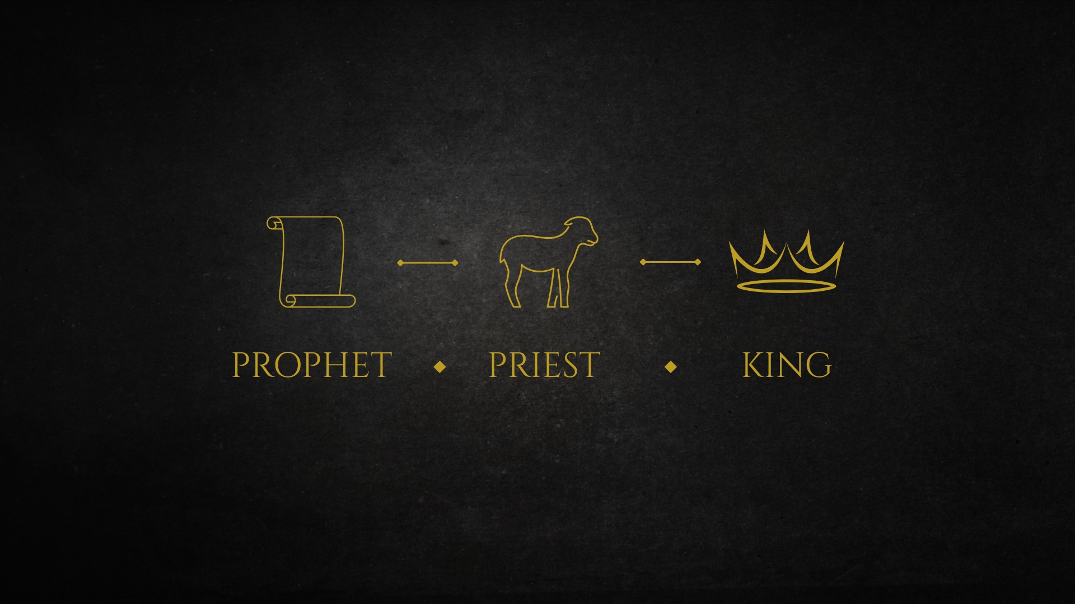

Slide 3
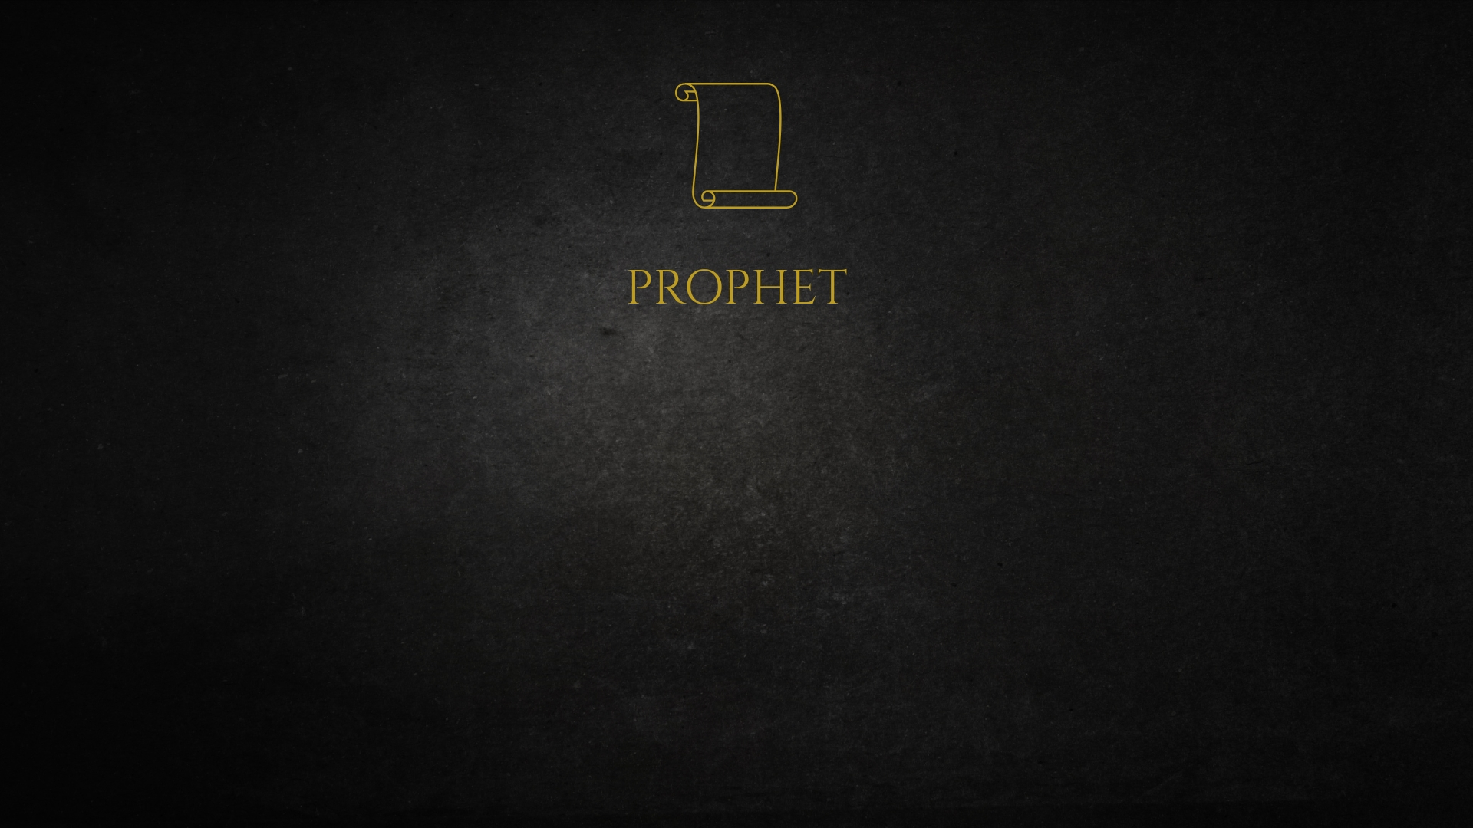
“God…has in these last days spoken to us by His Son”
The Superiority of His Revelation
Preeminence – Hebrews 1:2; Colossians 1:15-16; Job 38:1-4
Divine Nature – Hebrews 1:3; Colossians 2:9; John 1:14, 18; 2 Corinthians 4:6; John 12:37-41; 14:8-11
Providential Care – Hebrews 1:3; Isaiah 55:10-11; Zechariah 1:5-6

Slide 4
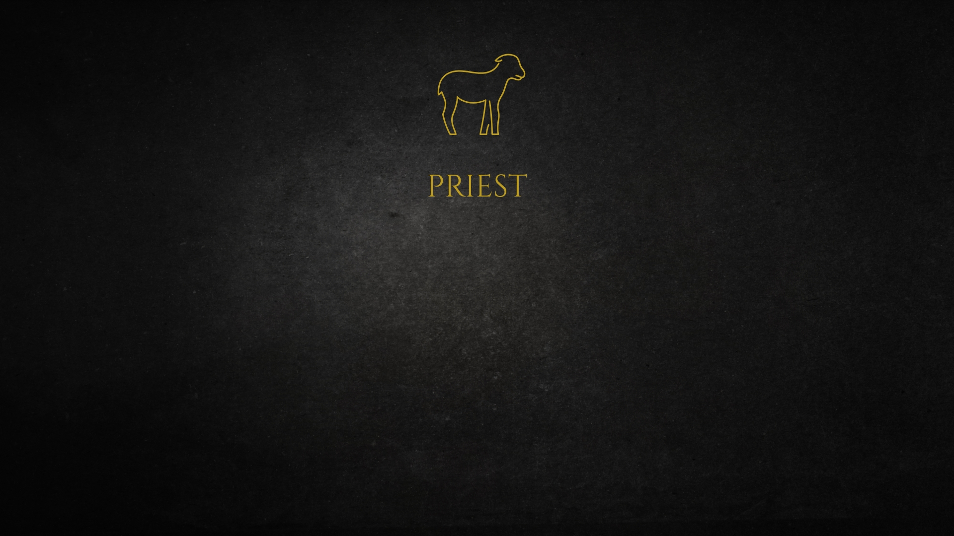
“He had by Himself purged our sins”
The Superiority of His Priesthood
Ministry – Isaiah 28:7-8; Ezekiel 22:26; Micah 3:11; Hebrews 7:26-27; 9:1, 9-12
Sacrifice – Hebrews 7:27; 10:1-4, 11-14
Intercession – Hebrews 5:1-3; Exodus 28:29; Zechariah 3:6-7; Hebrews 7:23-25; 4:14-16

Slide 5

“sat down at the right hand of the Majesty on high”
The Superiority of His Rule
Eternal – Hebrews 1:8a, 10-12; Psalm 146:3-4; Matthew 16:16-21; 1 Timothy 6:13-16
Righteous – Hebrews 1:8-9; Micah 3:1-3; Isaiah 32:1-8
Victorious – Hebrews 1:9, 13; 2:10-15; 6:19-20; Romans 8:37; 1 Corinthians 15:57; Revelation 5:9-10, 12-13

Slide 6
“Crown Him! Crown Him! Prophet, and Priest, and King!
Praise Him! Praise Him! Tell of His excellent greatness”

