Slide 2


Slide 3

We Must Remember Our Mission
John 4:27, 31-34; Matthew 4:4
This Mission Must Consume Us
“His disciples remembered that it was written, “ZEAL FOR YOUR HOUSE WILL CONSUME ME.”
John 2:17, NASB

Slide 4

We Reap the Labors of Others
John 4:35, 38
Lift up your eyes and look: blessings, opportunities (Ephesians 5:15-16), gratitude (Deuteronomy 6:10-12; Psalm 105:1-6)
We Enter into the Labors of Others
John 4:38; Ecclesiastes 2:18-21; Acts 20:18-21, 25-35 (Example, Teaching, Warning)

Slide 5
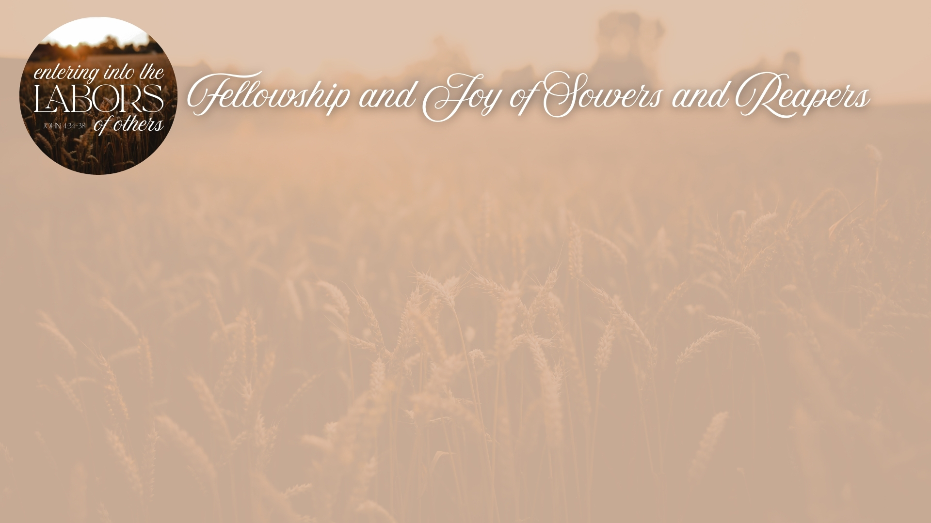
The Work Has Different Stages & Roles
John 4:37; 1 Kings 8:17-21
The Work is One
1 Cor. 3:8; John 4:36-37; Heb. 12:22-24; Amos 9:13
The Sowers and Reapers will Rejoice Together in Eternity
John 4:26; Heb. 11:39-40; 1 Thess. 4:15-18

Slide 6

We Must Have Generational Foresight
Genesis 18:19; Acts 2:39; Deuteronomy 29:14-15; 30:19-20; Judges 2:2-3, 7, 10-11
We Must Pray for More Laborers
Matthew 9:35-38; 1 Chronicles 29:16-19

