Slide 2
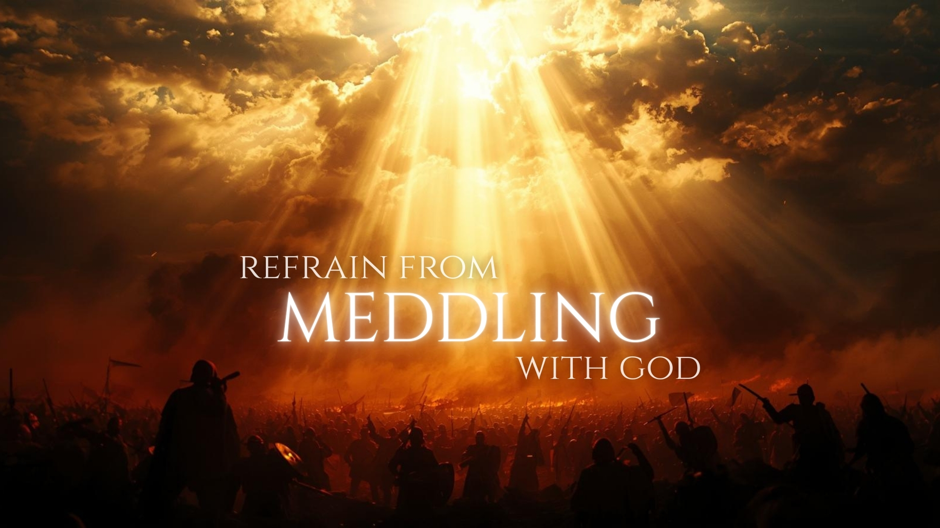

Slide 3
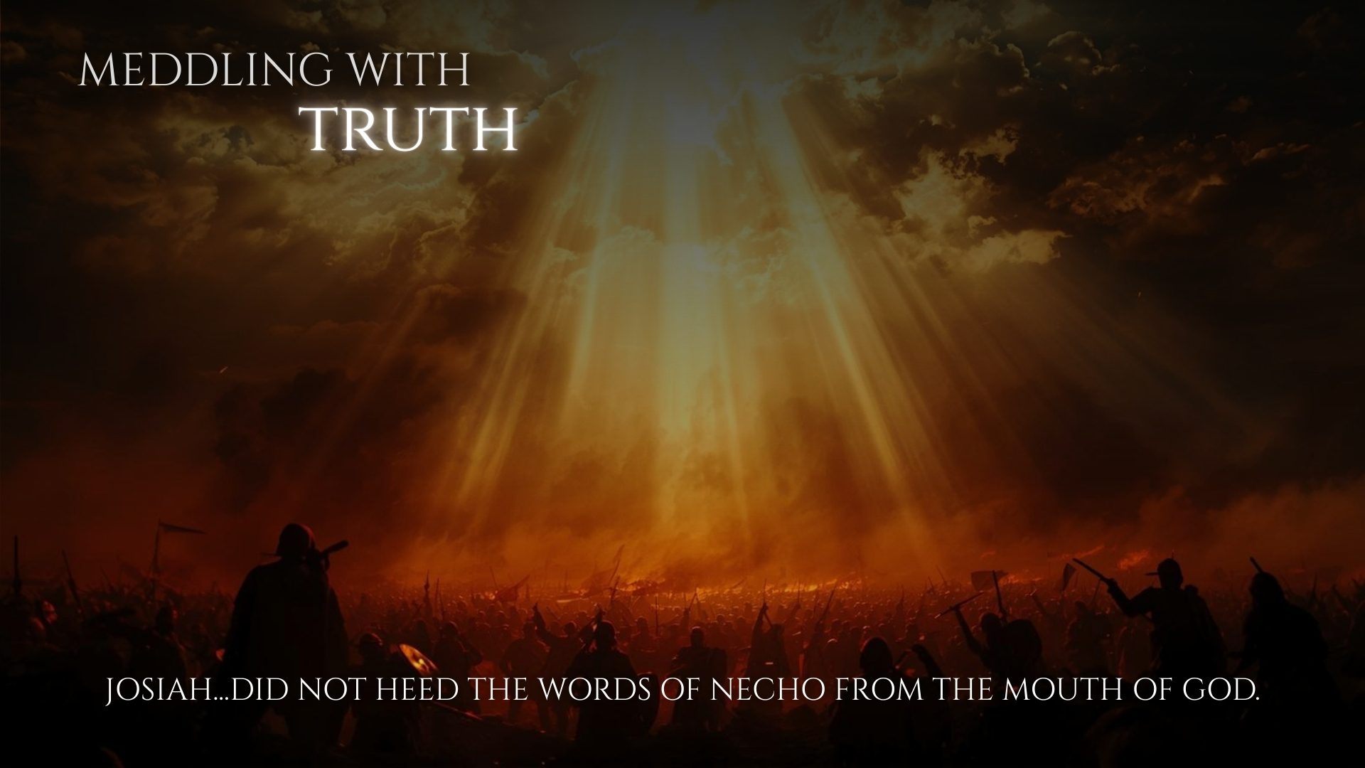
Many resist the truth – John 5:46-47; Acts 7:51; 2 Timothy 3:8; 2 Thessalonians 1:8; 2:11-12
  Ignorance and Immaturity – Ephesians 4:11-14; Romans 16:17-19
  Laziness – 2 Timothy 2:15; Luke 6:46-49
  Worldly Influence – Romans 12:1-2; 1 Corinthians 2:13-16
  Wrath – James 1:19-21

Slide 4
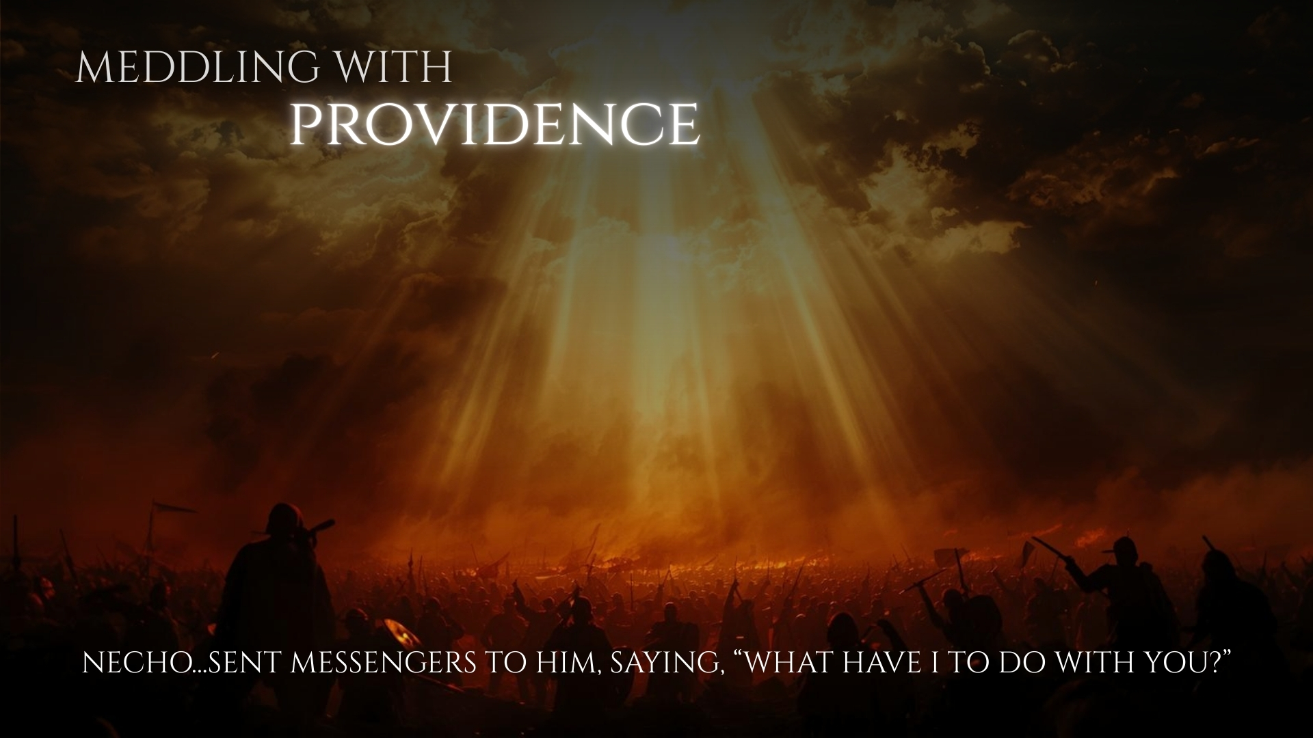
God wants us to view the world and our lives with the understanding that He is active in providence – Philemon 8-16; Amos 6:4-13
Christ is providentially active – Hebrews 1:3
If we ignore daily circumstances, or fail to consider that God is active providentially, we may be meddling with God:
  Impatient in Trial – James 1:2-4; 1 Peter 2:21
  Ignored Opportunities – Ephesians 5:15-17; Colossians 4:2-6; James 4:17

Slide 5

Authority comes from God (cf. Romans 13:1; Matthew 28:18), and our interactions with those in positions of authority reflect on our relationship with Him.
  Insubordinate Citizens – Matthew 22:15-22; 1 Peter 2:13-17
  Insubordinate Children – Colossians 3:20; Ephesians 6:1
  Insubordinate Wives – Ephesians 5:22-24, 33
  Insubordinate Members – 1 Thessalonians 5:12-13; 1 Timothy 3:4-5; Hebrews 13:17

Slide 6
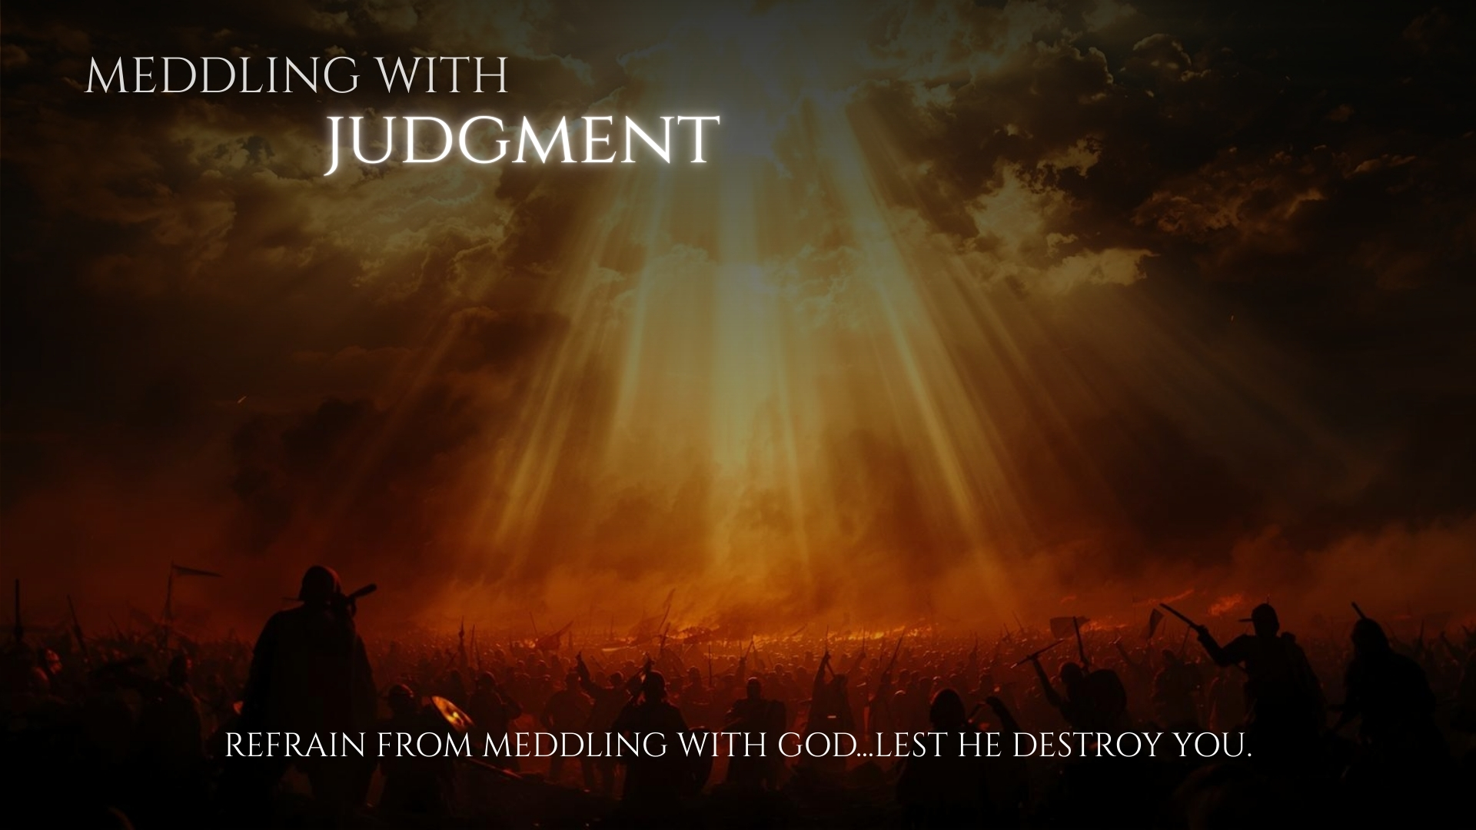
All men will stand before the judgment – Hebrews 9:27; Acts 24:24-25
None will escape the judgement – Hebrews 4:11-13
We must not meddle with the judgment:
  Delayed Obedience – 2 Peter 3:8-10
  Twisted Doctrine – 2 Peter 3:14-18; Jude 4
  Feigned Faith – 2 Timothy 2:15, 19-21

