Slide 2
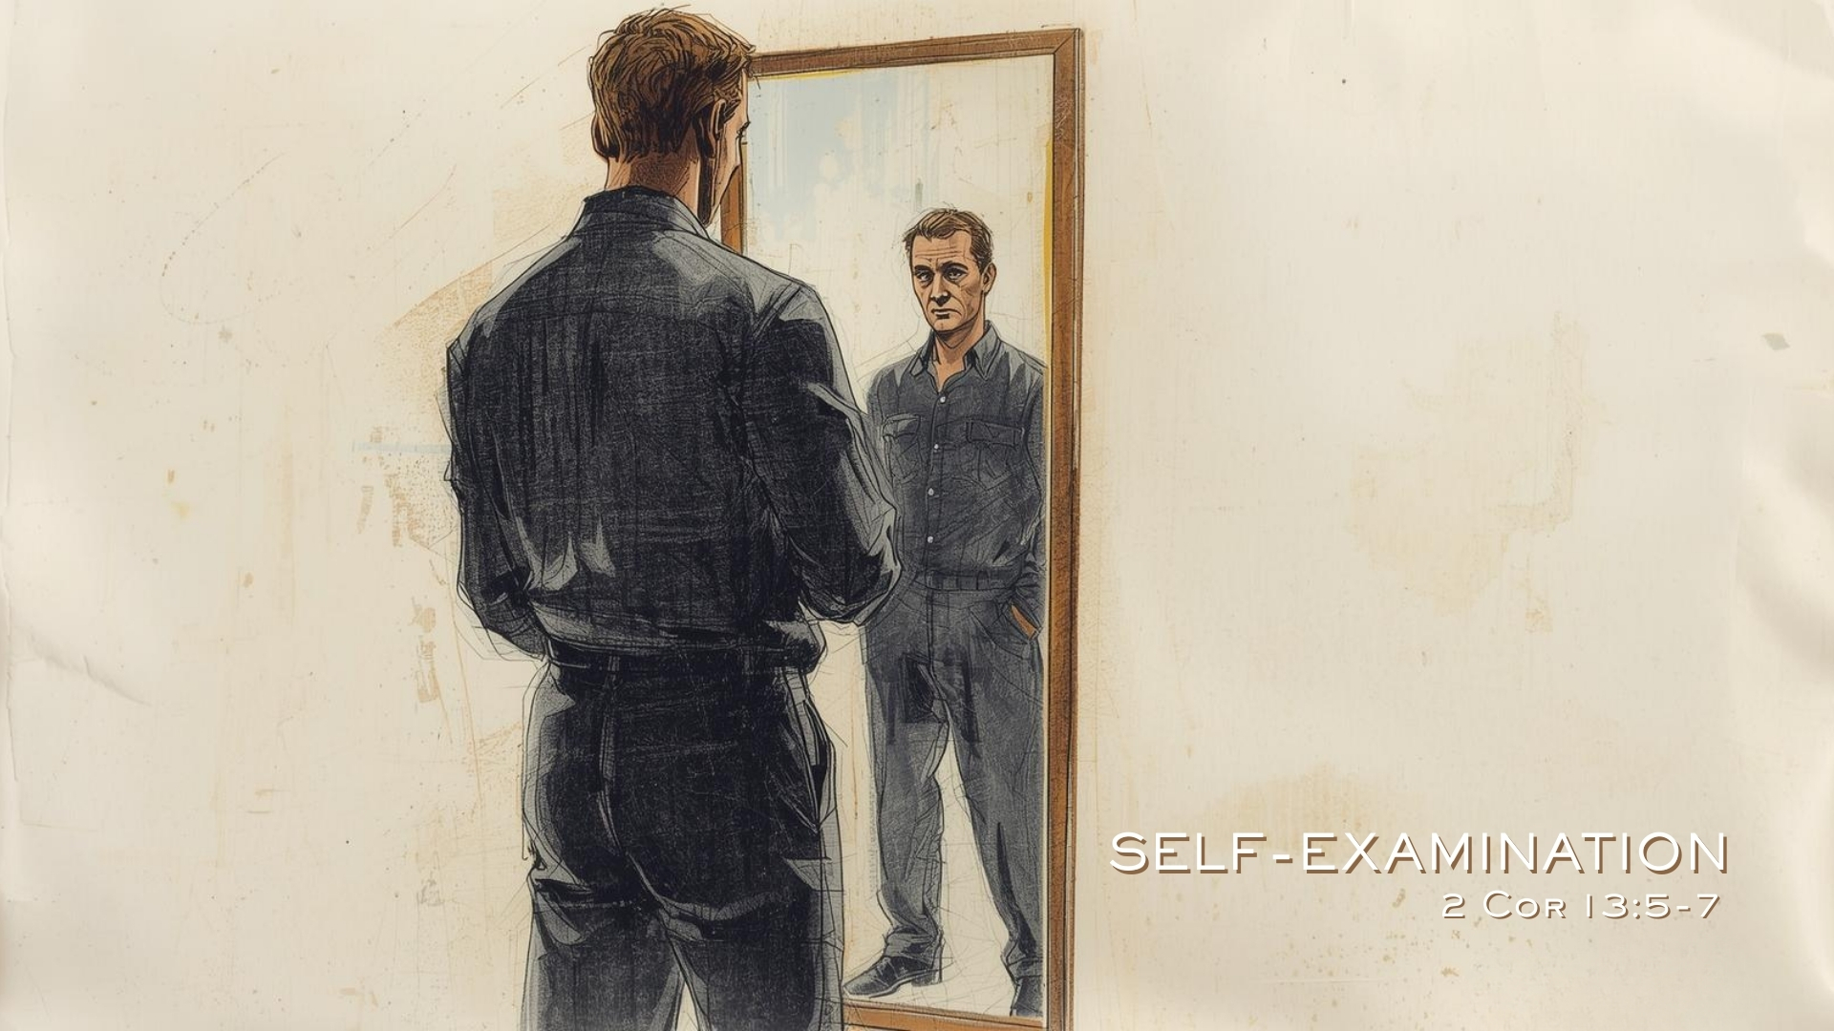

Slide 3
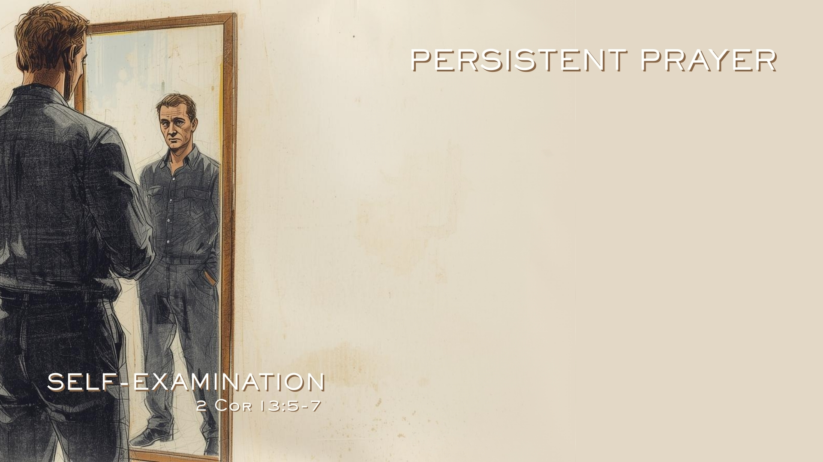
Prayer Intimately Involves God
Psalm 26:1-2; 139:1-6, 23-24; Revelation 8:3
Prayer Allows Expression of Sincere Desire for Fellowship with God
Psalm 26:3-12; 139:17-24

Slide 4
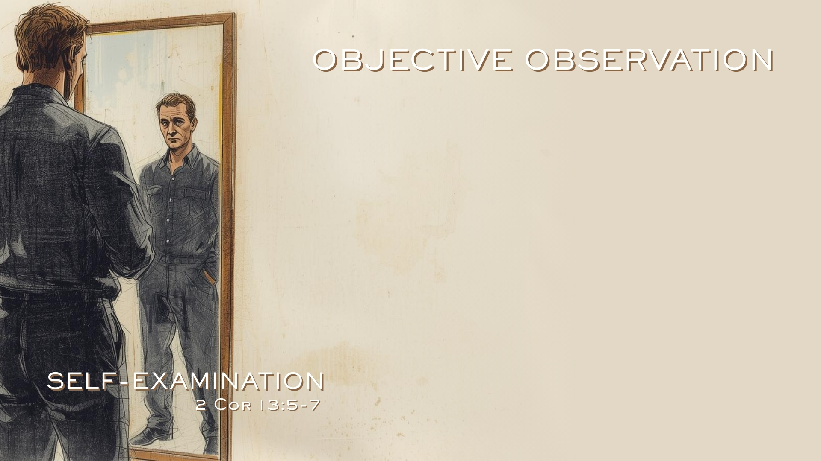
Self-Examination is Only Meaningful Under the Light of Truth
Psalm 119:105; John 11:9-10; Isaiah 2:5-8; Jeremiah 6:13-14; Psalm 19:7-9; 2 Timothy 3:16-17
God Provided Brethren as a Pattern
Proverbs 27:17; 1 Corinthians 11:1; 1 John 4:12, 20; Philippians 3:15-17

Slide 5

Pursue Self-Awareness Through Meditation
Psalm 1:2; Philippians 4:8-9; 1 Timothy 4:15; Psalm 4:4; 63:6; Revelation 2:23; Hebrews 4:12
Flee Self-Delusion
James 1:22-25
Have the Courage to Change
Galatians 1:23; Acts 9:1-2; 22:30-23:2; Philippians 3:407

