Slide 2


Slide 3
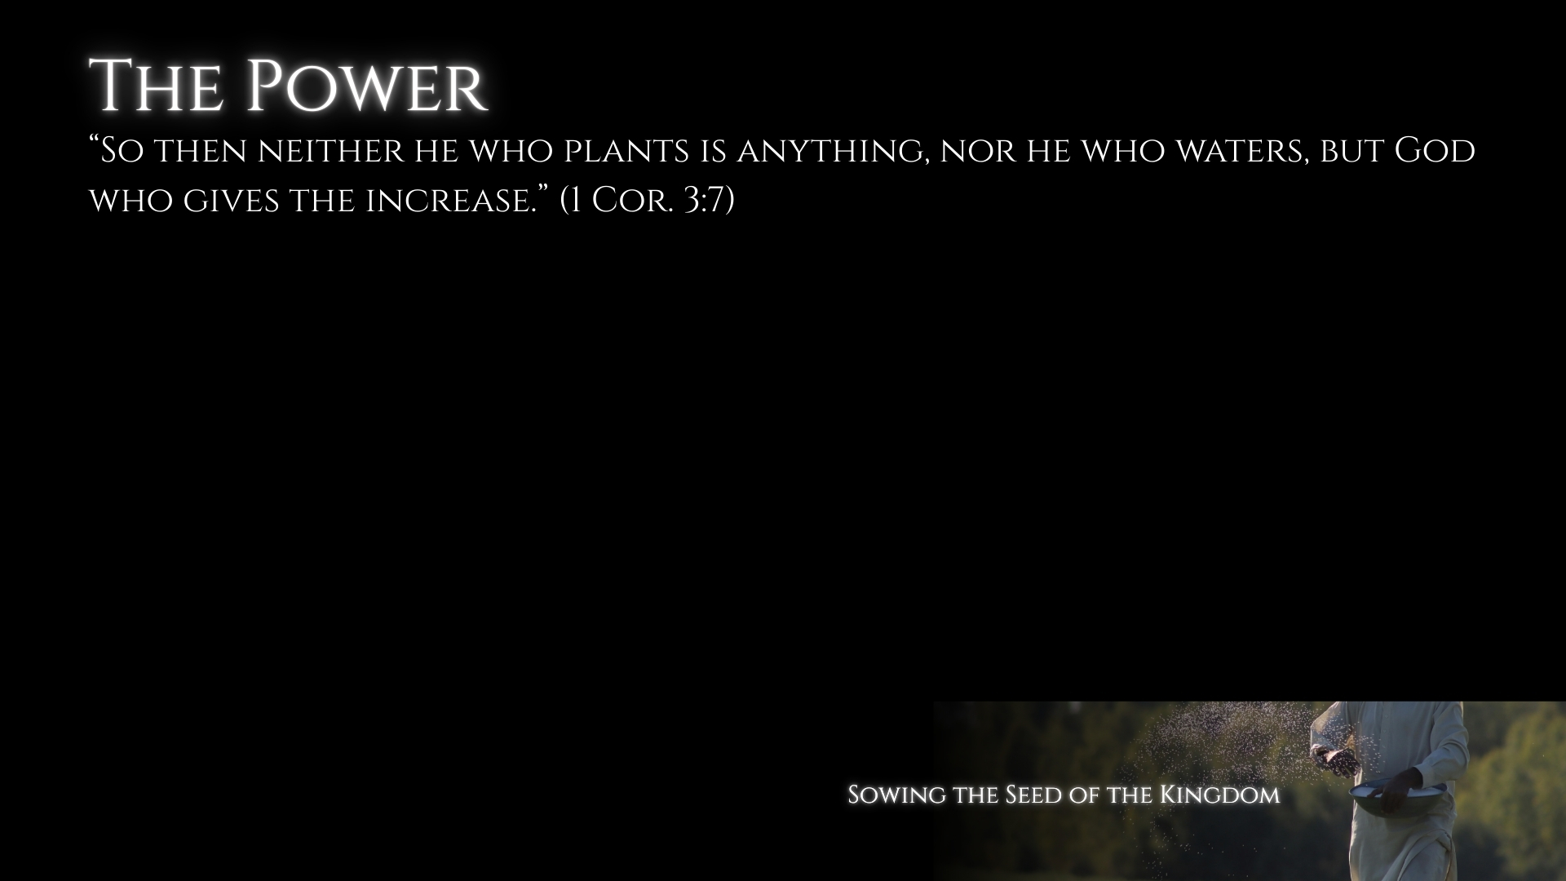
Mere Ministers and Simple Stewards
Ministers – 3:5-7, 9, 21-23
Stewards – 4:1-6
The proper perspective about myself – 1:26, 30-31
The Power is of God in the Gospel
The seed is the word – Luke 8:11; 1 Corinthians 3:7 (increase)
The message of the cross is the power –
1:18, 23-25; 2:2, 5; Rom. 1:15-16

Slide 4
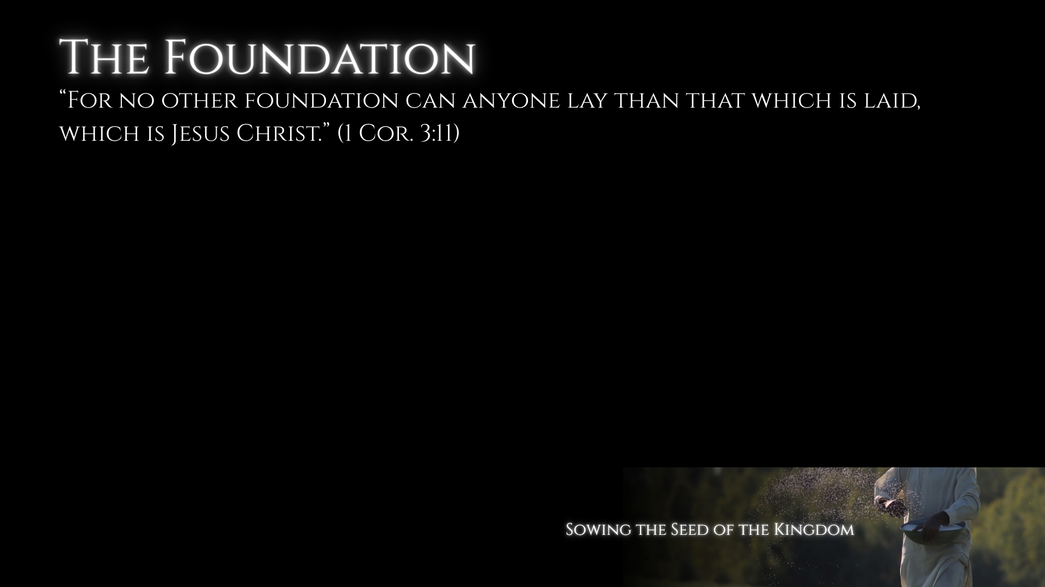
The Foundation of Jesus Christ
The power is God’s, but we must still preach – Romans 10:13-15; Mark 16:15
Not tricks, gimmicks, worldly wisdom, or watered down messages.
The foundation of Jesus Christ – 1:17-18, 20-21; 2:1-5; Ephesians 2:19-22

Slide 5
Wise Workers
Wise workers only preach Christ, and build on the foundation of Christ – (vv. 8, 10-11)
Not a new foundation – 1:17; 2:1; 3:16-17; Galatians 1:6-9
My responsibility is simply to plant and water – Colossians 4:4

Slide 6
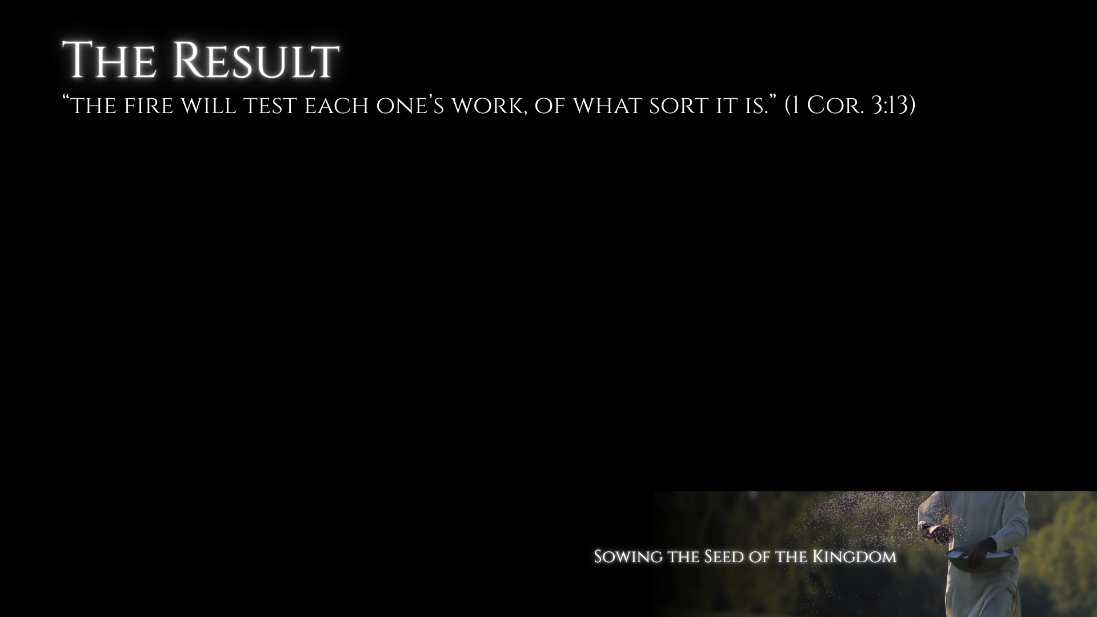
The Testing of Materials
Differing materials of each one’s work – (vv. 12-13)
  Not different approaches in teaching – (vv. 11, 15-17); 4:2, 5
The people are the building, materials tested by fire, the minister saved if he endures – (vv. 9, 13, 15)
Materials are the hearts – Matthew 13:18-23
I will not be judged for whether they are faithful, but for whether I teach – James 4:17

Slide 7
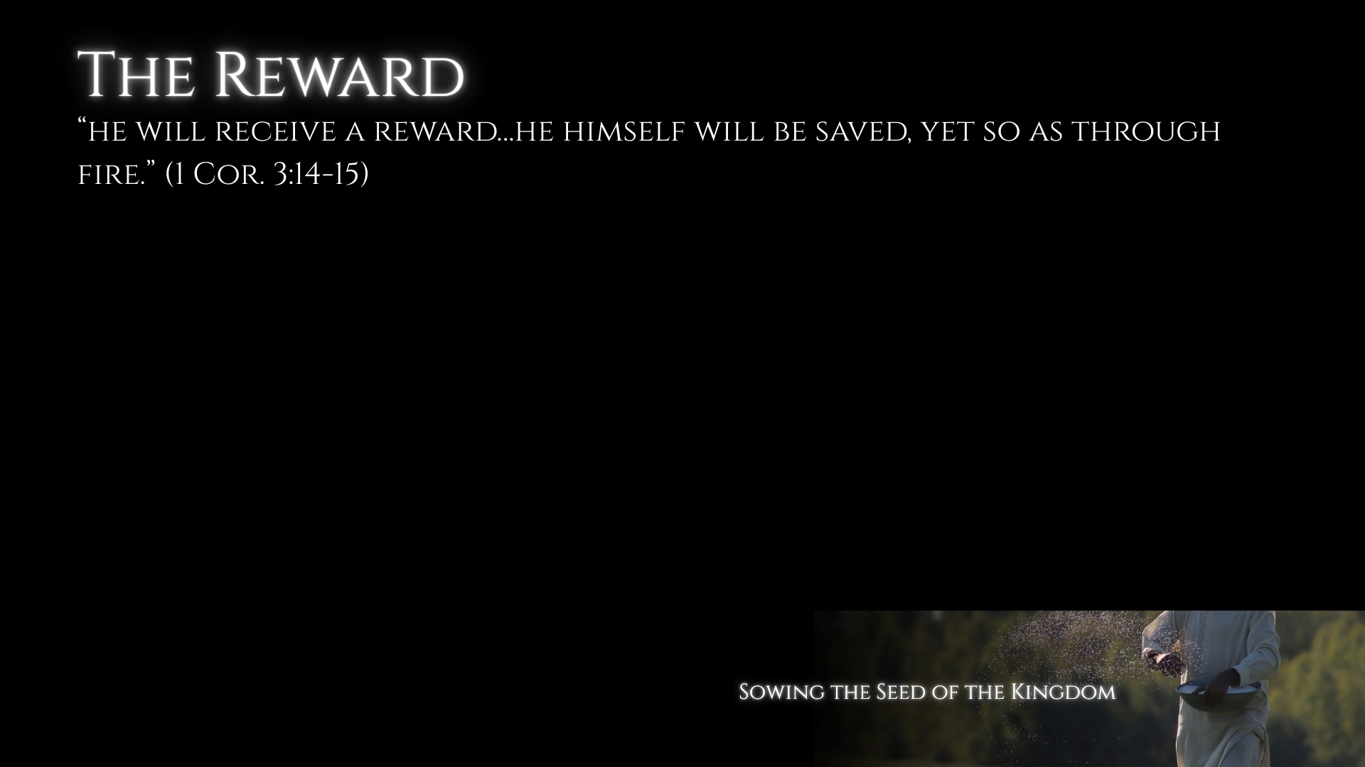
The Reward of Enduring Work
Distinct from individual salvation – (vv. 13, 15)
Paul’s attitude about others – Acts 26:28-29; Rom. 9:1-3; 10:1
Paul’s attitude about converts – Phil. 4:1; 1 Thess. 2:19-20
Paul’s view concerning converts falling away – Phil. 2:16; 1 Thess. 3:5; Galatians 4:11, 19-20

Slide 8
The Reward of Personal Salvation
“If anyone’s work is burned, he will suffer loss; but he himself will be saved, yet so as through fire.” (v. 15)

